Slide 1
FHIR for Architects (3 of 3)
Lloyd McKenzie
April 24, 2015

Slide 2
This presentation
Can be downloaded here:
http://gforge.hl7.org/svn/fhir/trunk/presentations/2015-04 Webinars/FHIR for Architects3.pptx
(use “anonymous” and email address)
Is licensed for use under the Creative Commons, specifically:
Creative Commons Attribution 3.0 Unported License
(Do with it as you wish – just give credit)

Slide 3
Agenda
Wednesday
Paradigms & Architecture approaches
Thursday
FHIR Features & Architecture decisions
Friday
Additional considerations, Profiles & Next steps

Slide 4
Additional Considerations
Notes:
10:00

Slide 5
Additional Considerations
Resolving identity
Missing data
Looping
Variable server capabilities
Prohibiting data elements
Interoperating with legacy

Slide 6
Resolving identity
Resource is electronic representation of real-world object
Can have multiple resource instances for same real-world object
Different servers or sometimes even same server
Ids for same resource on different servers can be completely different
Data on different servers can also vary
One resource multiple sites (with different ids)
Available data may vary

Slide 7
Resolving identity (cont’d)
Matching resources within and across servers is generally accomplished by business id (“identifier”)
May also have business “version”
Rules over changing business version are domain-dependent.
Where old versions my be maintained, each version might be distinct instance

Slide 8
Missing data
Extremely few resource or data type elements are required (minOccurs > 0)
Resources and data types are context independent
Extensions might supersede core elements
Therefore
Don’t assume data will be present
Always check for element/@value, not just element
May need to validate to a profile to enforce requirements

Slide 9
Looping
FHIR resources are interrelated in a network, not a hierarchy
Direct and indirect looping relationships are possible
In resource definitions & instances
Even if not possible with core elements, may occur with extensions
Parsing and processing algorithms must deal with this possibility
Notes:
E.g. Patient might update their own demographics. Organization might issue an identifier to itself, etc.

Slide 10
Variable Server capabilities
FHIR defines a number of mechanisms to give clients control of queries
Paging, many filters, _include, _summary, compartments
However, these are all optional . . .
What should a server do?
Cost/benefit trade-off
More you support, more clients will work with you
Some capabilities may be very expensive in some architectures
Do as much as you can, “within reason”

Slide 11
Variable Server capabilities (cont’d)
What should a client do?
Take advantage of desired capabilities, work with narrow set of servers
Works well in closed environments
Use minimal capabilities, work in most/all environments
Use advanced features where available, fallback to client processing where needed
More efficient but more complex client

Slide 12
Prohibiting data elements
In FHIR, you’re not allowed to prohibit unknown extensions
You can set a maxOccurs=0 for data elements, however
This forces clients to customize what they send you – bad practice
Better to accept and ignore
In limited cases, may be liability issues with ignoring data, so rejecting is necessary

Slide 13
Interoperating with legacy
How do you make FHIR play nicely with v2, v3, CDA?
Not enough time to cover here
Look at
http://hl7.org/fhir/comparison.html
https://healthlevelseven.desk.com
(members only)

Slide 14
Profiled FHIR
Notes:
10:00

Slide 15
Profile-less FHIR
You don’t need profiles to interoperate with FHIR
Resources are “discrete” enough that mechanism to populate most elements is clear
Approach
Populate/consume all elements you know, use HL7 or country-standard extensions for extras
Map to/from “recommended” terminologies as much as possible, populate CodeableConcept.text
Expose capabilities in Conformance resource

Slide 16
Uses for Profiles
Profiles are still quite useful
Define documents and messages
Define extensions, search parameters
Set interoperability expectations in a particular context
National standards, types of care, business patterns
Clinical practice guidelines / detailed clinical models
Document system capabilities
Only accept what you can understand (good/bad)
Interoperability standards
Clinical practice guidelines/DCMs

Slide 17
Profiles to guide behavior
Profiles can be used to dynamically configure system behavior
Load a profile to guide data entry
E.g. Oncology referral
Load a profile to guide data display

Slide 18
Simultaneous profiles
Multiple profiles can apply to an instance at the same time
Different codings for different value sets
Include the union of all needed elements
Works best when profiles don’t constrain max occurrences

Slide 19
Declaring profiles
Instances can identify what profiles they support using tags
Considerations:
Is declaration version-specific?
Do you trust the declaration to be accurate?
Will all clients declare the profiles of interest on submissions?
What about profiles of interest defined after data is received?

Slide 20
What now?
Notes:
10:00

Slide 21
Dealing with DSTU
FHIR is a “draft standard”
Anything can change – no compatibility promised
Changes driven by implementation feedback
Most changes expected in resources
Already significant implementation experience through reference implementations, connectathons
Some needed resources aren’t yet defined
Insurance, Referral, etc.
At least one more DSTU, possibly more before content becomes normative
What goes normative when will depend on degree of implementation

Slide 22
DSTU Strategies
If multiple DSTU versions could be in play
Distinguish using tags or distinct endpoints
Be prepared to transform between versions to move/rename elements or handle syntax changes
For missing resources
Use Basic
Create your own custom resource
Non-conformant, but ok during DSTU in closed community

Slide 23
FHIR adoption approaches
Low hanging fruit
Registries
Terminology
MHD (XDS)
CCDA interface
Patient Portals / Mobile Health
Others?

Slide 24
FHIR adoption approaches (cont’d)
Trial & experiment
Green-field
Pilots
“good fit” solutions (mobile, social media)
Elements not standardized elsewhere
Questionnaire, ConceptMap, etc.

Slide 25
FHIR adoption approaches (cont’d)
Deep dive
For the brave
Probably premature during DSTU period, given that specification is likely to change
Ability to adapt to change is essential

Slide 26
FHIR adoption approaches (cont’d)
Monitor
Wait for next DSTU, normative, jurisdictional direction (e.g. meaningful use)
Wait for stability in reference implementations
Wait to see more implementation experience
Ignore
FHIR isn’t relevant to my environment now and is unlikely to ever be
Notes:
If you think you’re in the last category, would love to chat with you

Slide 27

Estimating
How much will implementing a FHIR solution cost?
Considerations
Reference implementations help
Learning curve is lower
Still a curve if unfamiliar with XML / JSON / REST
Faster to “drive by” interoperability
Can’t speed consensus
Tools to help with mapping to internal codes and structures, still takes time
Anecdotal is “faster” to “significantly faster” to implement
Notes:
If I had a guaranteed answer, I’d be too busy to teach this course . . .

Slide 28
Skill requirements
To implement a FHIR solution, you’ll need:
Knowledge of XML and/or JSON
Some degree of familiarity with HTTP (assuming REST)
Likely someone knowledgeable in HTTP security and possibly OAuth

Slide 29
Considerations
What’s giving you pain now?
How could FHIR address those pain points?
What worries you about using FHIR?

Slide 30
Time-points for re-evaluation
Dec 2014: Draft for Comment Ballot
Now: DSTU 2 ballot
Summer 2015: DSTU 2 published
2017: First Normative specification
Additional releases every 12-18 months

Slide 31
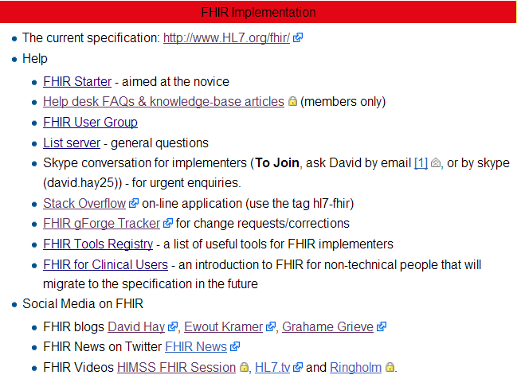
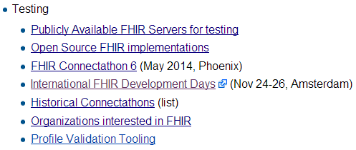
Resources wiki.hl7.org/?title=FHIR

Slide 32


Next Steps for you
Attend other FHIR tutorials
Developers, Profiles, Deep Dive
Read the spec: http://hl7.org/fhir
Comment in the discussion areas
Follow #FHIR on Twitter
Shape the specification:
Join the FHIR track at this WGM
Feedback – discussion, tracker, list server
Try implementing it
Come to a Connectathon!

Slide 33
Education opportunities
Attend a Working Group Meeting
Tutorials, Connectathons
May 8-14 Paris
October 2-9 Atlanta
Attend an Implementation Workshop
Intensive tutorials, hands-on
July 13-15 DC
November 16-18 Dallas
FHIR Institute Webinars
June 22-26, October 19-23
FHIR Developer Days
Amsterdam Nov 18-20th

Slide 34






International HL7 FHIR Developer Days November 18-20, 2015 in Amsterdam
Education
14 tutorials
pick & choose
Connectathon
Meet fellow developers
Put FHIR to the test
Networking
FHIR experts and authors on hand
http://fhir.furore.com/devdays

Slide 35
This presentation
Can be downloaded here:
http://gforge.hl7.org/svn/fhir/trunk/presentations/2015-04 Webinars/FHIR for Architects3.pptx
(use “anonymous” and email address)
Is licensed for use under the Creative Commons, specifically:
Creative Commons Attribution 3.0 Unported License
(Do with it as you wish – just give credit)

Slide 36

Questions?
http://hl7.org/fhir lmckenzie@gevity.com

